Slide 1




February 25th 2025
CAPSTONE
PROJECT
Safe Alert:
The Recall Tracking System
Team Members:
Nisrine Hafid
Thuong Pham
Soliyana Tenagne
Trent Korycinska
Will Peng

Slide 2



Mission Statement
Our company Safe Alert want's people to have access to safe and healthy foods when they go grocery shopping or out to eat. We are determined to provide our users with a FREE website that will track and notify users of recalled items. The Recall Tracking System website will be user friendly and informative, guaranteeing a safer shopping experience during any supermarket visit.

Slide 3
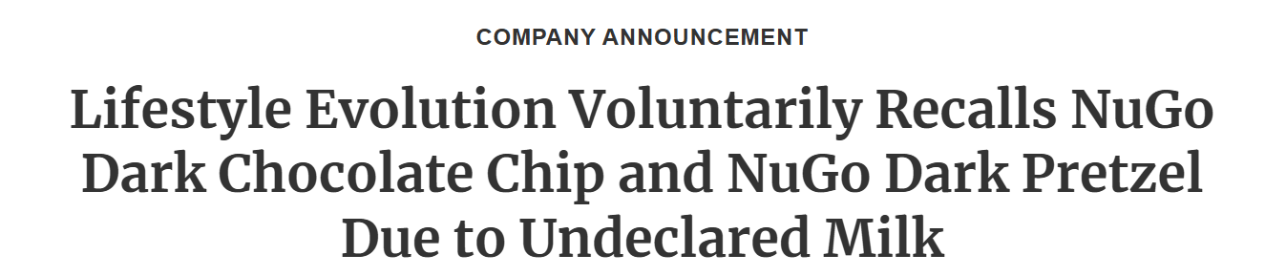
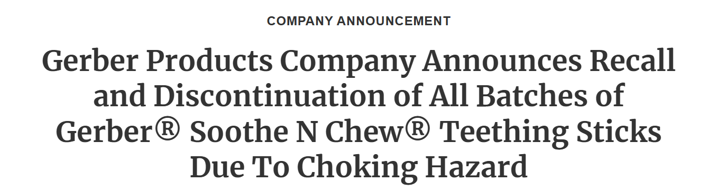
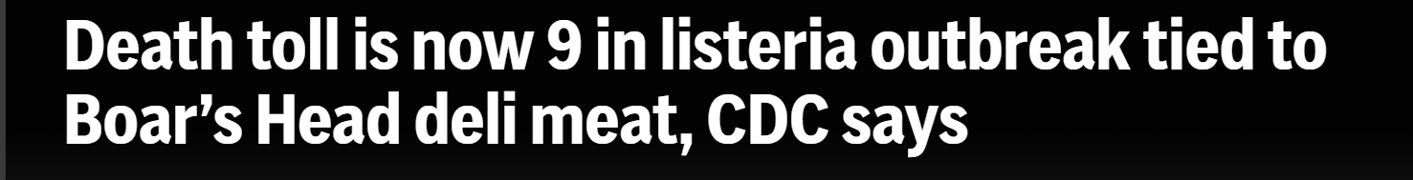
EXAMPLES OF RECALLS
January 10, 2025 – 11 Reports of Allergic Reactions
Lifestyle Evolution Voluntarily Recalls NuGo Dark Chocolate Chip and NuGo Dark Pretzel Due to Undeclared Milk | FDA
January 31, 2025 – Multiple Choking Incidents (Including 1 Emergency Room Visit)
Gerber Products Company Announces Recall and Discontinuation of All Batches of Gerber® Soothe N Chew® Teething Sticks Due To Choking Hazard | FDA
July 30, 2024 – 9 Deaths
8 deaths linked to listeria outbreak tied to Boar's Head deli meat, CDC says | AP News

Slide 4




WHAT IS THE PURPOSE OF THIS SITE?
The Recall Tracking System website will:
Track and notify users of recalled items
Provide accurate information on food products
Time-efficient
Organized
User friendly
Free!!!

Slide 5

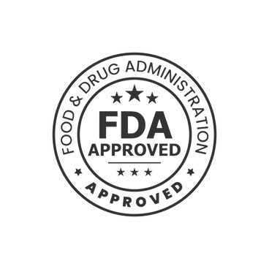


HOW MUCH ARE YOU WILLING TO PAY?
Resources/Tools:
Google Site (domain): free
Tableau Public: free
Marketing: free
Tik Tok
Instagram
Twitter
Facebook
API’s: free
FDA’s data
CDC’s data
Visual Studio: free
Python: free
HTML: free
CSS: free
Our company wants to start off as a non-profit, but we’re not opposed to making a profit in the future depending on the success of the website.

Slide 6
Donations
The service will be free to use, but donations will be accepted.
A "Donate" button will be available on the main navigation bar, allowing users to visit the donations page at any time.

Slide 7
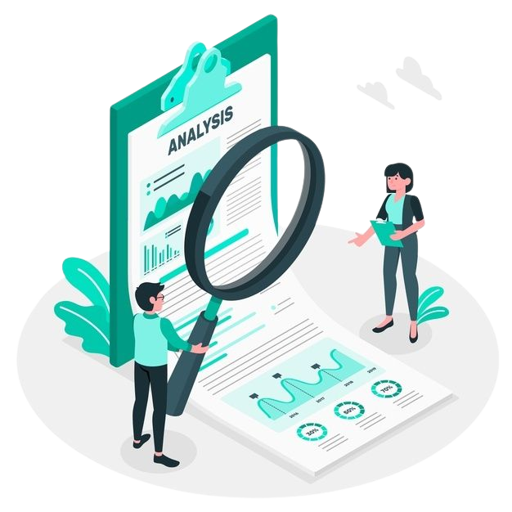


Families:
Mom’s
Dad’s
Grocery shopper for household
Restaurant owners
Cooks/chefs
Grocery chains
Schools
Hospitals
TARGET MARKET

Slide 8
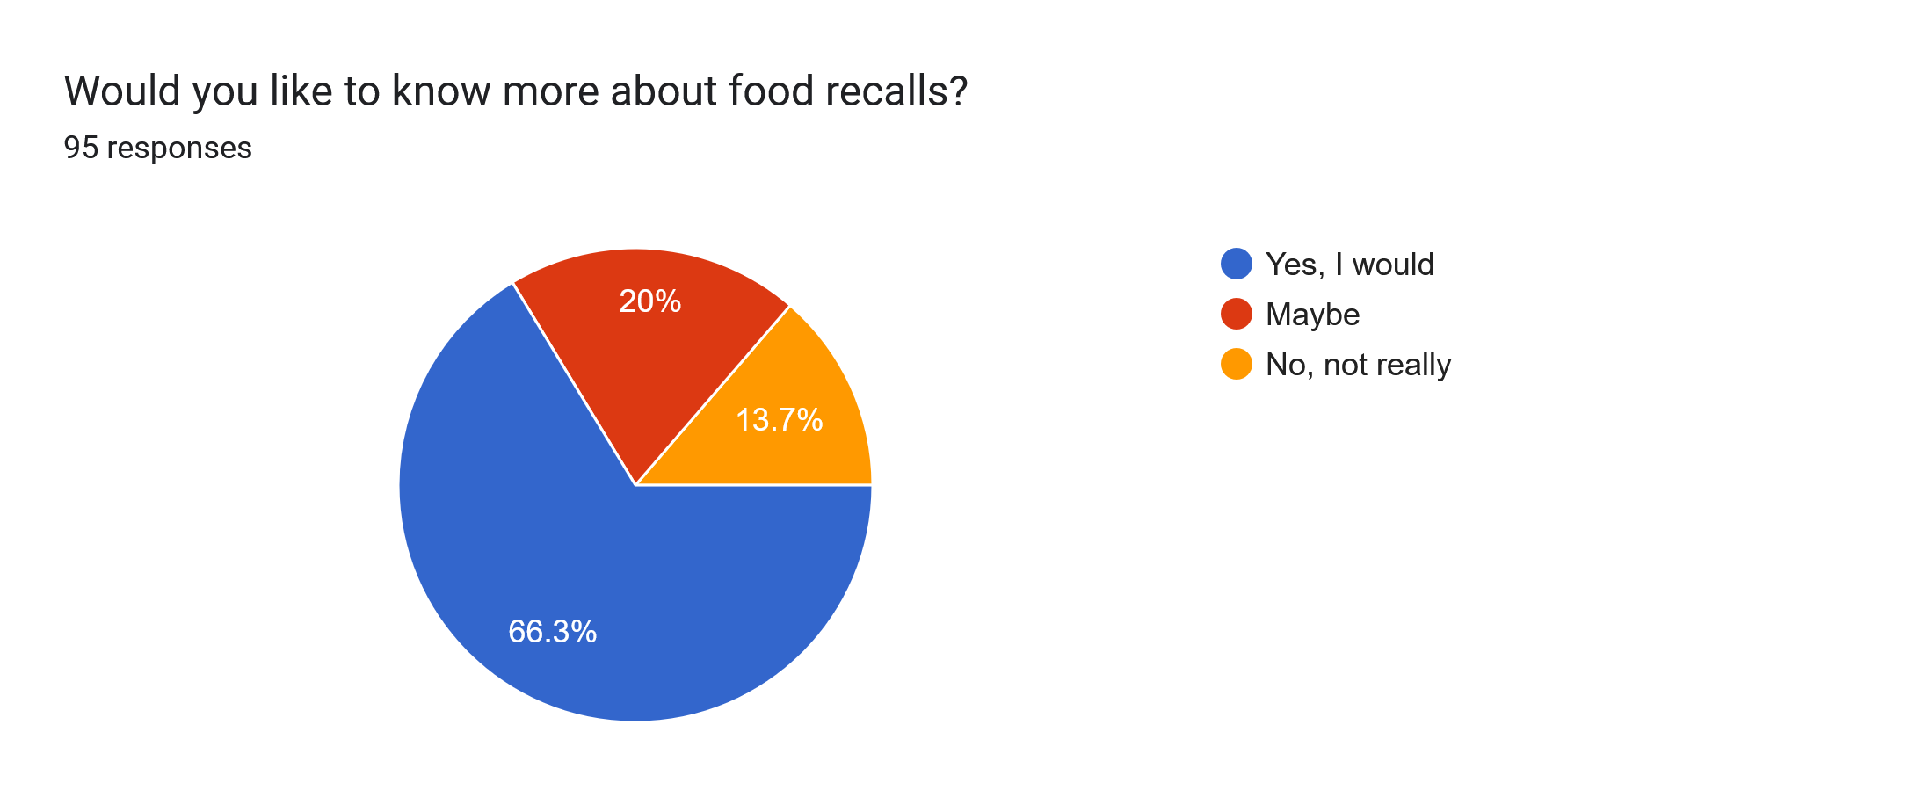

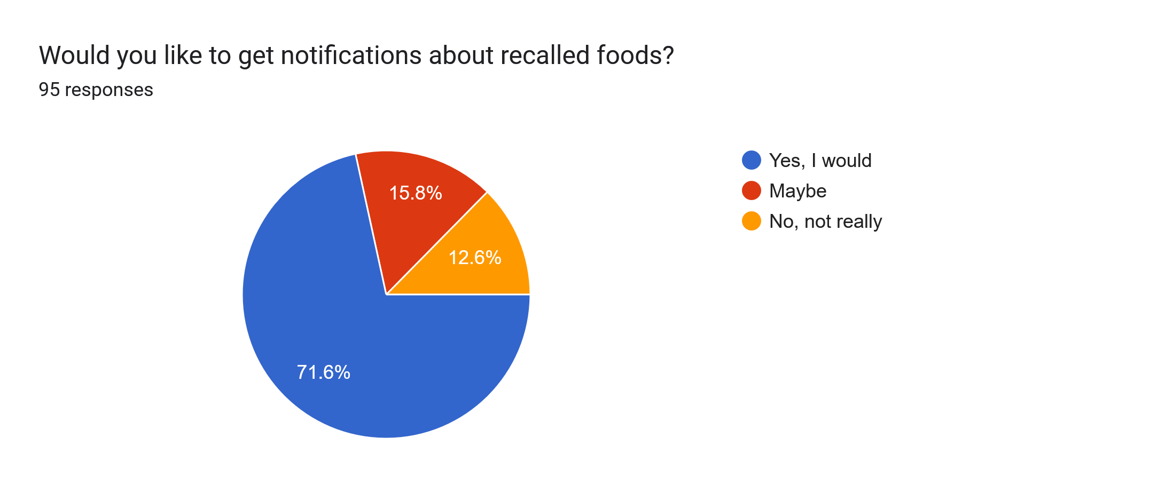
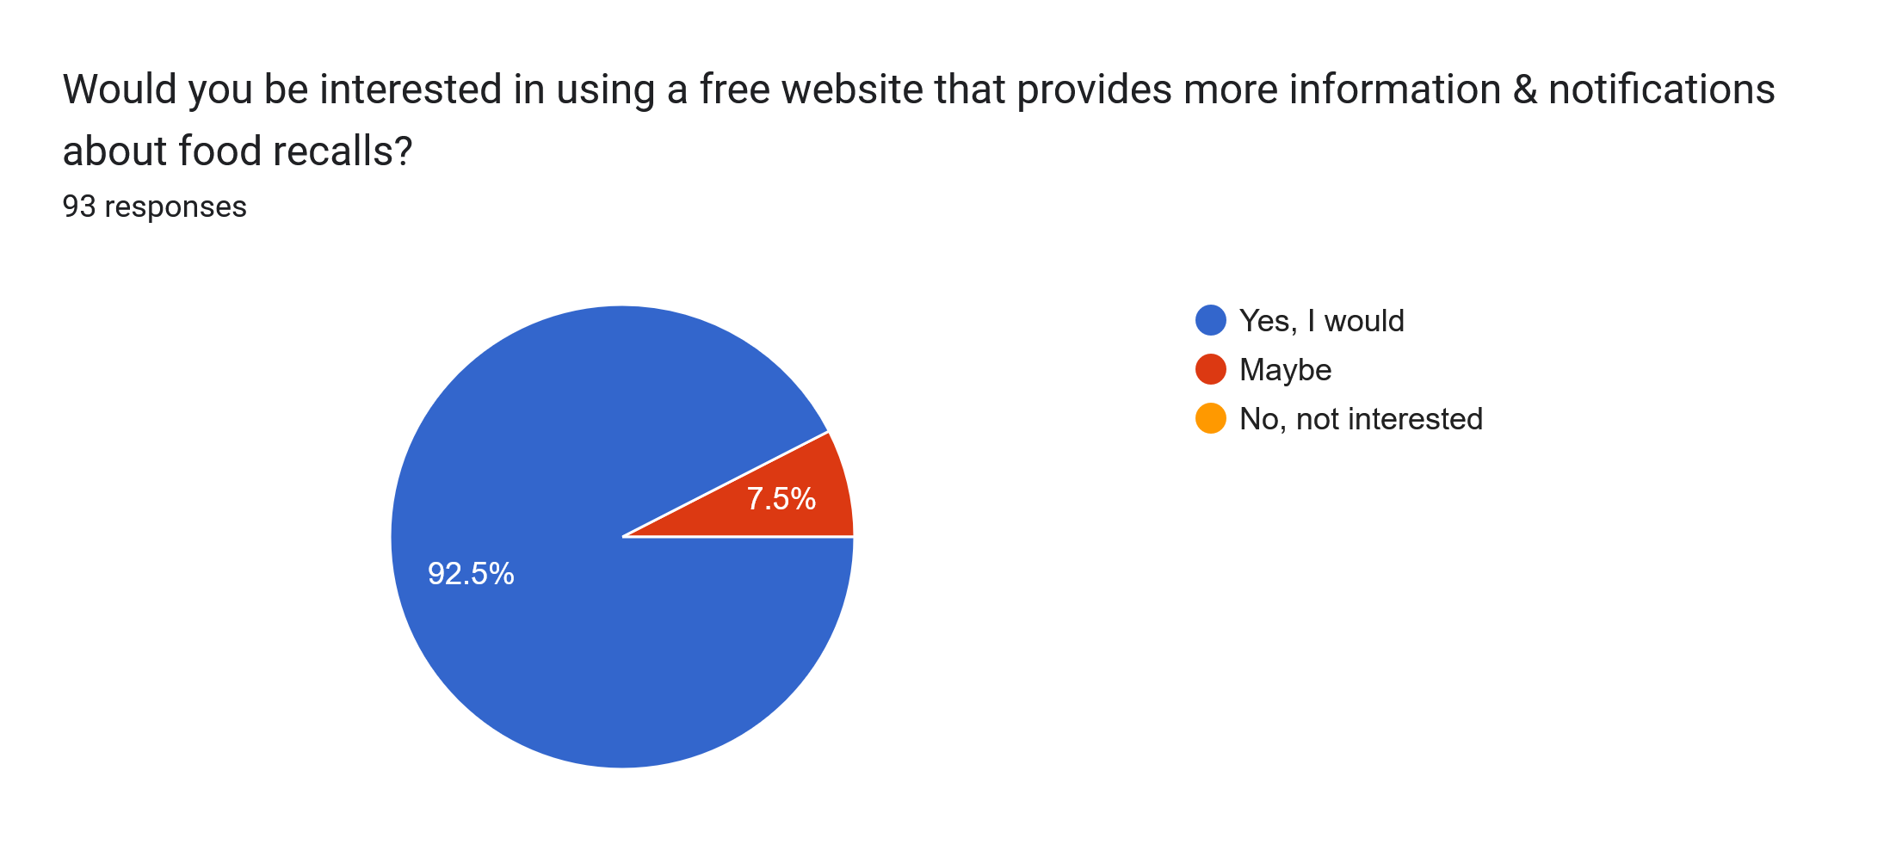
Survey Responses:

Slide 9
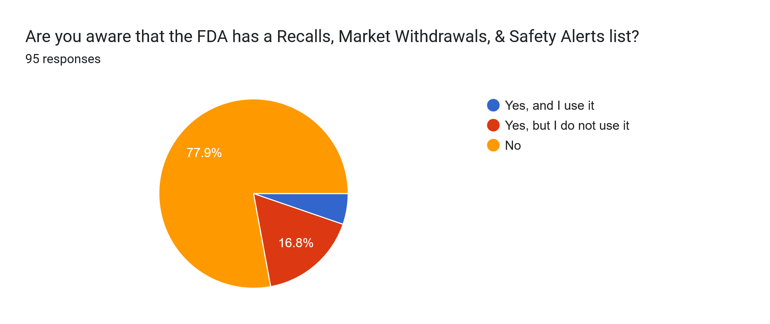
Survey Responses(cont'd):
Responses as of Feburary 17, 2025. Runtime of about 6 days.
Vast majority does not know the FDA list exists.
Similar number would like a free website that provides more information and notifications on food recalls.
Complete Survey Results

Slide 10



WHY WE ARE BETTER THAN OTHER COMPETITION
Likes:
Provides info on items outside of food
Dislikes:
Unorganized
No advertising
The Recall Tracking System Improvements:
Information and items will be categorized for quick and easy access
Website will be advertised and will draw in many demographics
Likes:
Has a very large audience
Interface can be very informative
Dislikes:
Does not focus entirely on recalls
Information user receives depends on their algorithm
The Recall Tracking System Improvements:
Website brings recall news to the forefront
Unlike Tik Tok our website will user friendly for all ages
(Tik Tok can be harder to use for someone who isn’t tech-savvy)
Likes:
Quick to collect data from various sources
Dislikes:
No notification system
The Recall Tracking System Improvements:
Website will have a fast and efficient notification system
Likes:
Provides pictures of items
Linked up with FDA announcements
Dislikes:
Not free, there are in app purchases to access features like a notification system
The app looks cluttered and unorganized, not pleasing to the eye
The Recall Tracking System Improvements:
Our website includes all these features in a more organized manner FOR FREE!!

Slide 11




MARKETING
We’re going to utilize free social platforms such as Instagram, Facebook, TikTok, twitter, etc.
There will be no paper mailing involved.
We will be advertising entirely online; we will have no business cards until we get bigger.

Slide 12

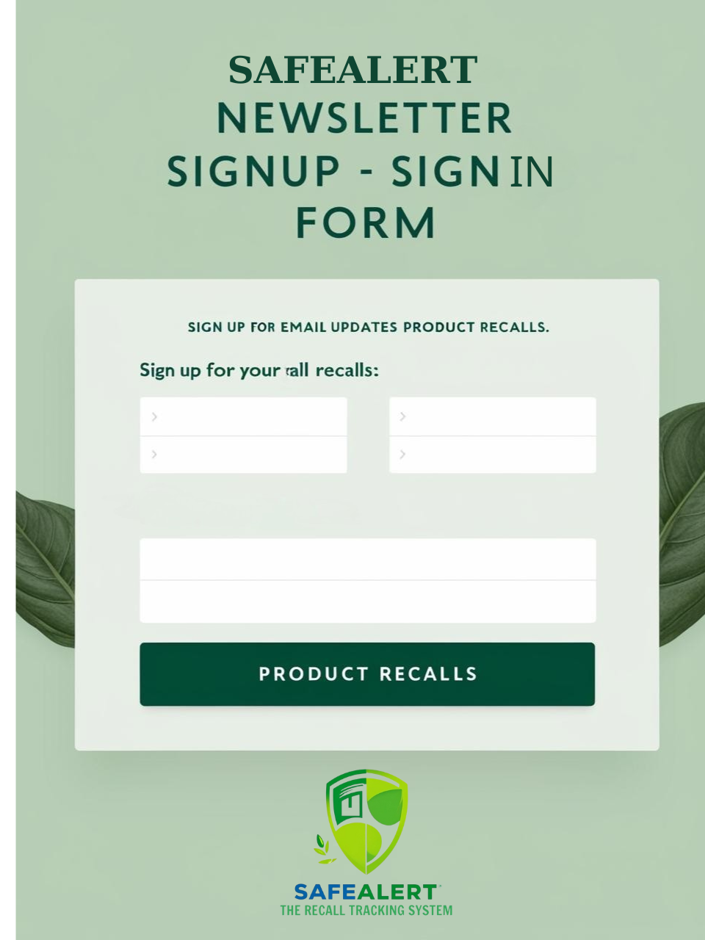
ONLINE ​
NEWSLETTER
Due to us providing a newsletter, we will be asking for anyone interested in receiving news and updates about recalls to sign up for our personal newsletter.​
​
To do this, we will be using Firebase to host and store all of those that signed up for our newsletter and use that database to automate sending out our updates.​
​

Slide 13




The Recall Tracking System
“ Track food recalls. Stay safe”
HOME | SUPPORT | RECALL ITEMS | NOTIFICATION SIGN UP
MEAT (2017-2025) | POULTRY (2017-2025) | SEAFOOD (2017-2025) | DAIRY (2017-2025) | FRUITS & VEGETABLES (2017-2025) | FROZEN FOOD (2017-2025)
Filter
You can filter your search by date or brand name here
DATE | BRAND NAME(S): | DESCRIPTION: | PRODUCT TYPE: | REASON FOR RECALL

Slide 14

THANK YOU

